Slide 1
1-2: Data Classification
We are going to check 1.1 practice problems today
Notes on 1.2

Slide 2
Types of Data
Qualitative data: consists of attributes, labels, or nonnumerical entries.
Ex: Location, Political Party, race
Quantitative data: consists of numerical measurements or counts.
Ex: Prices, height, length, income
CAUTION: Not all numbers are quantitative data.
Ex: Student ID Number or seat number

Slide 3
Classifying types of data (7 – 15 odd)
Telephone numbers in a directory
Answer: Qualitative
Body temperatures of patients
Answer: Quantitative
Lengths of songs
Answer: Quantitative
Player numbers on jerseys
Answer: Qualitative

Slide 4
Levels of Measurement
Nominal level (qualitative only): categorized by names, labels, or qualities.
Ordinal level (qualitative or quantitative): arranged in an order, ranked, but the numbers do not carry any mathematical amount.
Interval level (quantitative only): can be ordered and meaningful difference between the numbers can be calculated. Zero entry represents a position, not an inherent zero.
Ratio level (quantitative only): similar to interval level, but zero is an inherent zero.

Slide 5
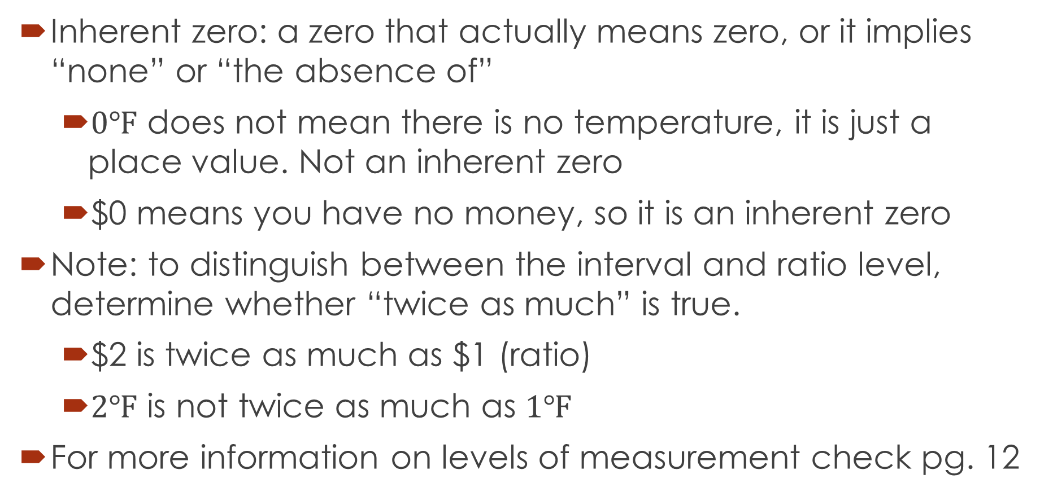
Levels of Measurement
Inherent zero: a zero that actually means zero, or it implies “none” or “the absence of”
$0℉$ does not mean there is no temperature, it is just a place value. Not an inherent zero
$0 means you have no money, so it is an inherent zero
Note: to distinguish between the interval and ratio level, determine whether “twice as much” is true.
$2 is twice as much as $1 (ratio)
$2℉$ is not twice as much as $1℉$
For more information on levels of measurement check pg. 12

Slide 6
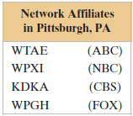
Classifying Data by Level
1)
2)
Ordinal
Nominal

Slide 7
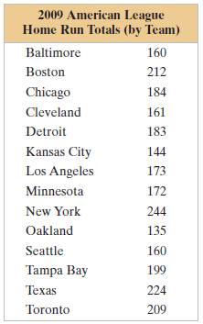
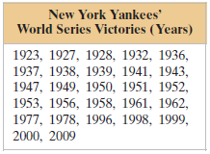
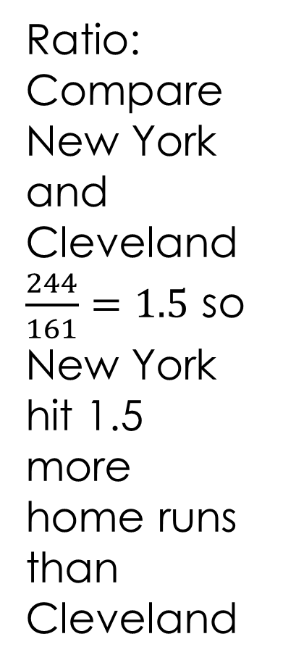
Classifying Data by Levels
Ratio:
Compare New York and Cleveland
$\frac{244}{161}=1.5$ so New York hit 1.5 more home runs than Cleveland
3)
4)
Interval:
It is a list of years, it does not make sense to say on year is a multiple of the other.

Slide 8
Summary of The Four Levels of Measurement
Level of measurement | Put data in categories | Arrange data in order | Subtract data values | Determine if one data value is a multiple of another and inherent zero
Nominal | Yes | No | No | No
Ordinal | Yes | Yes | No | No
Interval | Yes | Yes | Yes | No
Ratio | Yes | Yes | Yes | yes

Slide 9
 | Example of a Data Set | Meaningful Calculations
Nominal Level (qualitative Data) | Types of Music Played by a Radio Station: Pop Contemporary jazz Modern Rock Hip Hop | Put in a category. For instance, a song played by the radio station could be put into one of the four categories shown.
Ordinal Level (Qualitative or quantitative data) | Motion Picture Association of America Ratings Descriptions G general Audiences PG Parental Guidance Suggested PG-13 Parents Strongly Cautioned R Restricted NC-17 No One Under 17 Admitted | Put in a category and put in order. For instance, a PG rating has a stronger restriction than a G rating.

Slide 10
 | Example of a Data Set | Meaningful Calculations
Interval Level (Quantitative data) | Average monthly Temperature (in degrees Fahrenheit) for Sacramento, Ca: 46, 75, 51, 74, 54, 71, 59, 64, 65, 53, 71, 45 | Put in a category, put in order, and find differences between values. For instance, 71.5 – 65.5 =6 So June is 6 degrees warmer than May
Ratio Level (Quantitative Data) | Average Monthly Precipitation (in inches) for Sacramento, CA 4, .1, 3.5, .1, 2.8, .4, 1, 1, .5, 2.2, .2, 2.5 | Put in a category, put in order, find differences between values, and find ratios of values. For Instance 1/.5 = 2. So, there is twice as much rain in April as in May.

Slide 11
Assignment
Pg. 13 #1 – 22, 25 – 29, 31
www.Gallup.com

