Slide 1
4.2 Binomial Distributions

Slide 2
Binomial Distributions
Binomial Distribution: A probability experiment that results in two possible outcomes: success or failure.
Conditions:
1. The experiment is repeated for a fixed number of trials, where each trial is independent of the other trials.
2. There are only two possible outcomes of interest for each trial. That can be classified as a success $(S)$ or as a failure $(F)$
3. The probability of a success, $P(S)$, is the same for each trial.
4. The random variable x counts the number of successful trials.

Slide 3
Binomial Distributions: Notation
Symbol | Description
$$n$$ | The number of times a trial is repeated
$$p=P(S)$$ | The probability of success in a single trial
$$q=P(F)$$ | The probability of failure in a single trial $(q=1−p)$
$$x$$ | The number of successes amongst the trials
From a standard deck of cards, you pick a card, note whether it is a club or not, and replace the card. You repeat the experiment five times. What are the values for $n, p, q,$ and the possible values for $x$?
$n=5$ (number of trials)
$p=13/52$ (the probability of drawing a club)
$q=39/52$ (the probability of not drawing a club)
$x=0, 1, 2, 3, 4, 5$ (possible number of successes

Slide 4
Identifying and Understanding Binomial Experiments
Decide whether the experiment is a binomial experiment. If it is, specify the values of n, p, and q, and list the possible values of the random variable x. If it is not, explain why.
1. A certain surgical procedure has an 85% chance of success. A doctor performs the procedure on eight patients. The random variable represents the number of successful surgeries.
Answer: $n=8, p=.85, q=.15, x=$ any numbers $0−8$
2. A jar contains five red marbles, nine blue marbles, and six green marbles. You randomly select three marbles from the jar, without replacement. The random variable represents the number of red marbles.
Answer: It is not a binomial experiment because the probability does not stay the same throughout all the trials.

Slide 5
Binomial Probability Formula
$P\left(x\right)=nCxp^{x}q^{n−x}$
Example:
1) Microfracture knee surgery has a 75% chance of success on patients with degenerative knees. The surgery is performed on three patients. Find the probability of the surgery being successful on exactly two patients. (Hint: start by identifying the notation)
Answer: $n=3, x=2, p=.75, q=.25$ $$P\left(x\right)=3C2{\left(.75\right)}^{2}{\left(.25\right)}^{1}=3\left(.5625\right)\left(.25\right)≈.422$$

Slide 6
Finding Binomial Probabilities
A card is selected from a standard deck and replaced. This experiment is repeated a total of five times. Find the probability of selecting exactly three clubs.
Answer: $n=5, x=3, p=\frac{13}{52}, q=\frac{39}{52}$ $5C3{\left(\frac{13}{52}\right)}^{3}{\left(\frac{39}{52}\right)}^{2}=10\left(.015625\right)\left(.5625\right)≈.088$

Slide 7
Finding Binomial Probabilities
A survey indicates that 41% of women in the United States consider reading their favorite leisure-time activity. You randomly select four U.S. women and ask them if reading is their favorite leisure-time activity. Find the probability that (1) exactly two of them respond yes, (2) at least two of them respond yes, and (3) fewer than two of them respond yes.

Slide 8
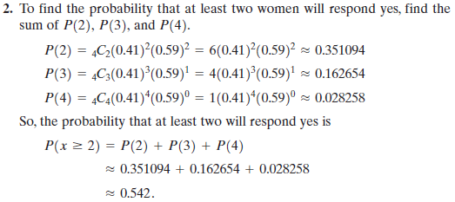
Finding Binomial Probabilities (cont)

Slide 9
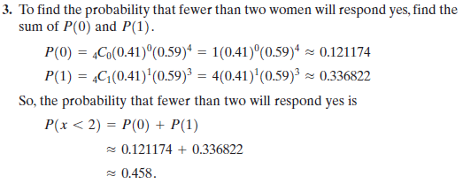
Finding Binomial Probabilities (cont)

Slide 10
Finding Binomial Probability Using Technology
Hit $2^{nd}$
DISTR (VARS)
scroll to binompdf(
enter the values for $n, p,$and $x$ separated by a comma
Hit enter
Example:
The results of a recent survey indicate that 67% of U.S. adults consider air conditioning a necessity. If you randomly select 100 adults, what is the probability that exactly 75 adults consider air conditioning a necessity? Use a technology tool to find the probability.
Answer: binompdf(100, .67, 75)$= .0201$

Slide 11
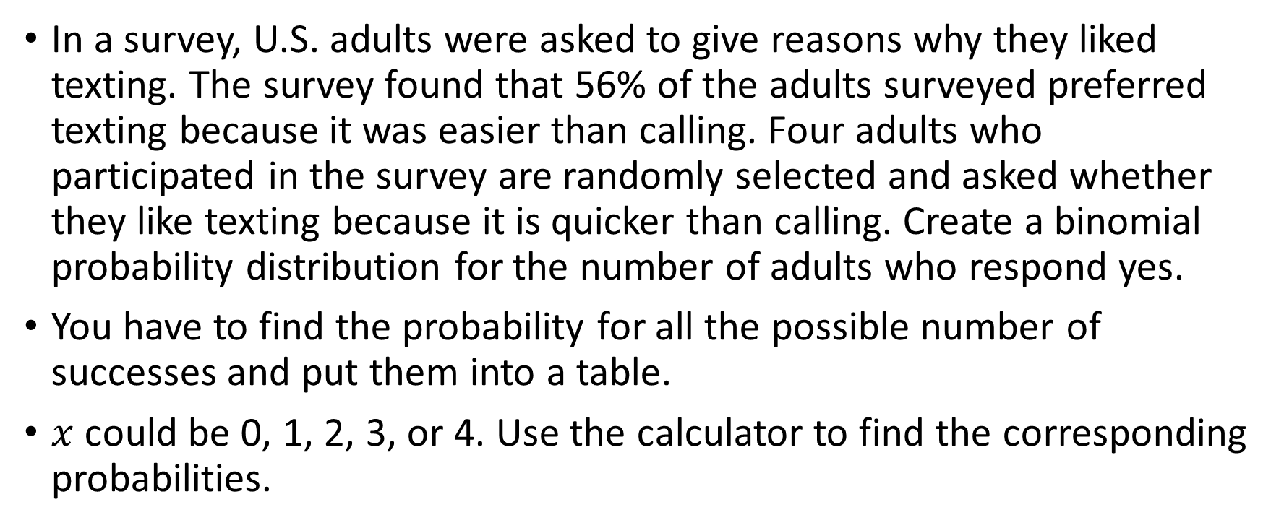
Binomial Probability Distribution (list of possible $x$ values with the corresponding probabilities)
In a survey, U.S. adults were asked to give reasons why they liked texting. The survey found that 56% of the adults surveyed preferred texting because it was easier than calling. Four adults who participated in the survey are randomly selected and asked whether they like texting because it is quicker than calling. Create a binomial probability distribution for the number of adults who respond yes.
You have to find the probability for all the possible number of successes and put them into a table.
$x$ could be 0, 1, 2, 3, or 4. Use the calculator to find the corresponding probabilities.

Slide 12
Population Parameters of a Binomial Distribution
Mean: $μ=np$
Variance: $σ^{2}=npq$
Standard Deviation: $σ=\sqrt{npq}$
Example:
In Pittsburgh, Pennsylvania, about 56% of the days in a year are cloudy. Find the mean, variance, and standard deviation for the number of cloudy days during the month of June. Interpret the results and determine any unusual values.
Answer: $n=30, p=.56, q=.44$ and now plug them into the formulas. Mean is 16.8, Variance is 7.4, and the Standard Deviation is 2.7

Slide 13
Practice Problems
Pg. 211 #1, 2, 9 – 13, 21, 23, 25, 30, 31

