Slide 1
5.5 Normal Approximations to Binomial Distributions
Bellwork (Review): A doctor has an 85% chance of success during a surgical procedure. The doctor performs the procedure 10 times during a week.
What is the probability of exactly 2 successful surgeries?
What is the probability of 3 or 4 successful surgeries?
Remember: in a binomial distribution, $μ=np$ and $σ=\sqrt{npq}$

Slide 2
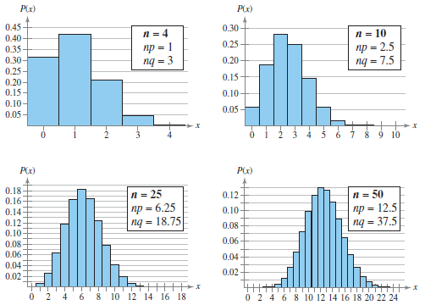
Normal Approximation to a Binomial Distribution
If $np≥5$ and $nq≥5,$ then the binomial random variable x is approximately normally distributed, with mean $μ=np$ and a standard deviation $σ=\sqrt{npq}.$

Slide 3
Decide whether you can use the normal distribution to approximate x, the number of people who reply yes. If you can, find the mean and standard deviation. If you cannot, explain why.
Sixty-two percent of adults in the United States have an HDTV in their home. You randomly select 45 adults in the United States and ask them if they have an HDTV in their home.
Twelve percent of adults in the United States who do not have an HDTV in their home are planning to purchase one in the next two years. You randomly select 30 adults in the United States who do not have an HDTV and ask them if they are planning to purchase one in the next two years.

Slide 4
Continuity Correction
The binomial distribution is discrete while the normal model is continuous.
Since there are gaps under the curve, we need to expand the numbers a by .5 on either side.

Slide 5
Using the Continuity Correction
Use a continuity correction to convert each of the following binomial intervals to a normal distribution interval.
Simply, subtract .5 from the lowest value and/or add .5 to the highest.
Or if x is bigger than the number, subtract .5. If x is smaller than the number, subract .5
The probability of getting between 270 and 310 successes, inclusive
Answer: $269.5<x<310.5$
2. The probability of getting at least 158 successes ($x≥158$)
Answer: $x>157.5$
3. The probability of getting fewer than 63 successes ($x<63$)
Answer: $x<62.5$

Slide 6
Using a Normal Distribution to Approximate Binomial Probabilities
Decide if it is binomial and find $n, p,$ and $q$.
Decide if the normal model is appropriate ($np≥5$ and $nq≥5$)
Find the mean and the standard deviation
Apply continuity correction
Find the z-score
Find the probability (normalcdf)

Slide 7
Approximating a Binomial Probability
Sixty-two percent of adults in the United States have an HDTV in their home. You randomly select 45 adults in the United States and ask them if they have an HDTV in their home. What is the probability that fewer than 20 of them respond yes?

Slide 8
Approximating a Binomial Probability
Fifty-eight percent of adults say that they never wear a helmet when riding a bicycle. You randomly select 200 adults in the United States and ask them if they wear a helmet when riding a bicycle. What is the probability that at least 120 adults will say they never wear a helmet when riding a bicycle?

Slide 9
Approximating a Binomial Probability
A survey reports that 62% of Internet users use Windows® Internet Explorer® as their browser. You randomly select 150 Internet users and ask them whether they use Internet Explorer® as their browser. What is the probability that exactly 96 will say yes?

Slide 10
Practice Problems
Pg. 287 #2 – 18 even, 24 – 28

