Slide 1
6.1 Confidence Intervals for the Mean (Large Samples)

Slide 2
Terminology
A point estimate is a single value estimate for a population parameter. The best estimate for $μ$ is $\overline{x}$.
An interval estimate is an interval, or range of values, used to estimate where a population parameter might be.
The difference between the point estimate and the actual parameter value is called the sampling error

Slide 3
Example 1
A social networking website allows its users to add friends, send messages, and update their personal profiles. The following represents a random sample of the number of friends for 40 users of the website. Find a point estimate of the population mean then find the standard deviation of the sample.

Slide 4
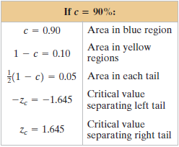
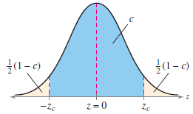
Level of Confidence
The level of confidence c is the probability that the interval estimate contains the population parameter.
The level of confidence c is the area under the standard normal curve between the critical values, $−z_{c}$ and $z_{c}$.

Slide 5
Finding critical values
What is the critical value for a level of confidence of 95%?
What is the critical value for a level of confidence of 99%?
What is the critical value for a level of confidence of 90%?

Slide 6
Margin of Error
Given a level of confidence c, the margin of error E, is the greatest possible distance between the point estimate and the value of the parameter it is estimating.
$E=z_{c}σ_{\overline{x}}=z_{c}\left(\frac{σ}{\sqrt{n}}\right)$
This assumes that we know that $σ$ equals which rarely occurs
If we do not know $σ$ and $n≥30$, then we can use the sample standard deviation (s) in place of $σ$.

Slide 7
Example 2: Find the Margin of Error
Use the data given in Example 1 and a 95% confidence level to find the margin of error for the mean number of friends for all users of the website.

Slide 8
Confidence Interval
A confidence interval is created by adding or subtracting the margin of error to the point estimate for a population parameter.
The confidence interval is the range that the population parameter is expected to be in based on a set confidence level.
The confidence interval for the mean is $\overline{x}±E$
The probability that the confidence interval contains the mean is the confidence level.

Slide 9
Example 3: Constructing a Confidence Interval
Remember that the $\overline{x}=130.8,$the $s=52$, and $E=16.$1 from the data for example 1. Construct a 95% confidence interval for the mean number of friends for all users of the website.

Slide 10
Example 5: Using Technology
Use a technology tool to construct a 99% confidence interval for the mean number of friends for all users of the website using the sample in Example 1.
Enter the data into the list
Go to STAT
Scroll to TESTS
Scroll down to Zinterval
Select DATA, enter the standard deviation, List: whichever list your data is in, Freq: 1, C-Level: .99
Hit Calculate
Use technology to construct a 97% confidence interval for the mean number of friends for all users of the website using the sample in Example 1.

Slide 11
List from Example 1

Slide 12
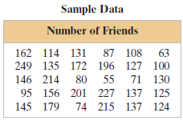
Example 6: Bringing it all together
Another random sample of the number of friends for 30 users of the website is shown below. Use this sample to construct a 95% confidence interval for the mean number of friends for all users of the website.

Slide 13
Example 6: Constructing a Confidence Interval, $σ$ Known
A college admissions director wishes to estimate the mean age of all students currently enrolled. In a random sample of 20 students, the mean age is found to be 22.9 years. From past studies, the standard deviation is known to be 1.5 years, and the population is normally distributed. Construct a 90% confidence interval of the population mean age.

Slide 14
Find a Minimum Sample Size to Estimate $μ$
Given a c-confidence level and a margin of error E, the minimum sample size n needed to estimate the population mean, $μ$, is
$$n={\left(\frac{z_{c}σ}{E}\right)}^{2}$$
If $σ$ is unknown and $n≥30$, then we can use $s$ to approximate.

Slide 15
Example 7: Determining Minimum Sample Size
You want to estimate the mean number of friends for all users of the website. How many users must be included in the sample if you want to be 95% confident that the sample mean is within seven friends of the population mean?
Remember: $c=.95, z_{c}=1.96, s=52.63$

Slide 16
Practice Problems
Pg. 311 #1 – 6, 12 – 14, 22, 24, 27, 36, 38, 51, 52, 54

