Slide 1
Module: Organizing and Summarizing Data 2.1 Frequency Distributions and Their Graphs
Grab a calculator on the way in

Slide 2
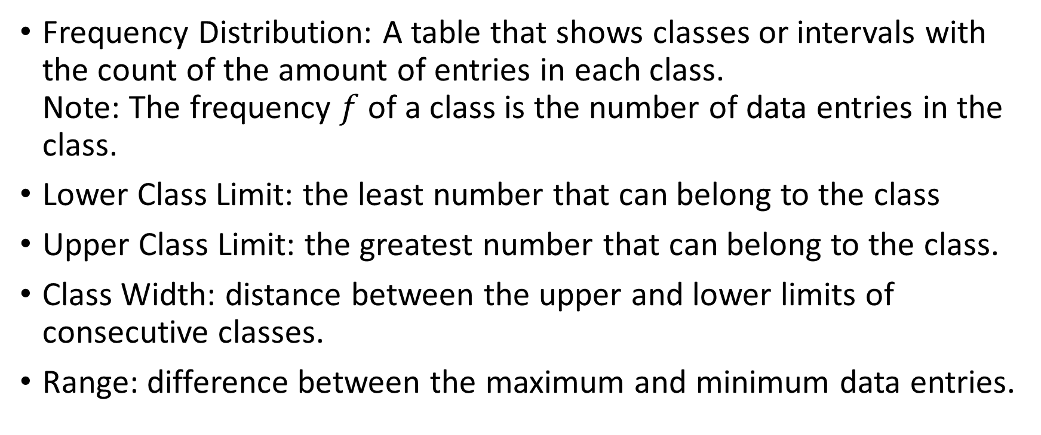
Frequency Distributions
Frequency Distribution: A table that shows classes or intervals with the count of the amount of entries in each class. Note: The frequency $f$ of a class is the number of data entries in the class.
Lower Class Limit: the least number that can belong to the class
Upper Class Limit: the greatest number that can belong to the class.
Class Width: distance between the upper and lower limits of consecutive classes.
Range: difference between the maximum and minimum data entries.

Slide 3
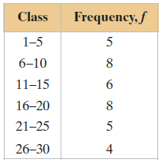
Understanding the Vocab
Identify the lower and upper class limits.
Answer: Lower: 1, 6, 11, 16, 21, 26 Upper: 5, 10, 15, 20, 25, 30
Identify the class width.
Answer: $6−1=5$
Assume the maximum data entry is 28 and the lowest is 2. Find the range for the frequency table.
Answer: $28−2=26$
Note: This table does not give specific entries, just a count.

Slide 4
Guidelines for Constructing a Frequency Distribution (not a one size fits all)
Decide on the number of classes in the distribution. Should be between 5 and 20.
Find the class width: Determine the range, divide it by the number of classes, and round up.
Find the class limits. Use the minimum entry and add the class width, that gives you the lower limit for the next class. Classes cannot overlap.
Tally each data entry per row in the corresponding class.
The tally marks give you the frequency per class.

Slide 5
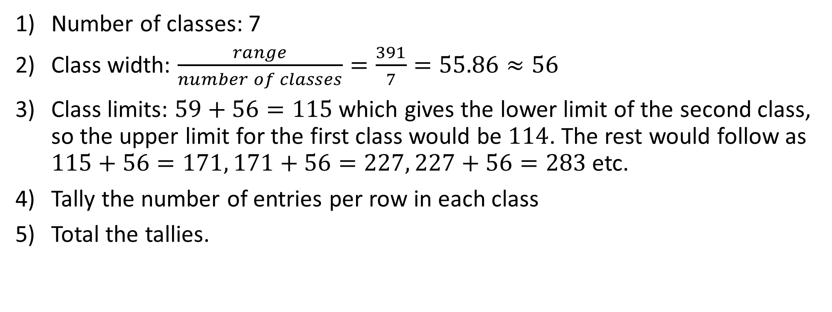
Example: Construction
Number of classes: 7
Class width: $\frac{range}{number of classes}=\frac{391}{7}=55.86≈56$
Class limits: $59+56=115$ which gives the lower limit of the second class, so the upper limit for the first class would be $114$. The rest would follow as $115+56=171, 171+56=227, 227+56=283$ etc.
Tally the number of entries per row in each class
Total the tallies.

Slide 6
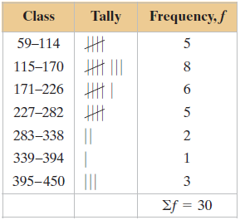
Example: Construction cont.
One example of the table would look like this. The final table would not have the tallies.
Tip: Add the frequency column up and make sure it equals the number of total entries you started with.
Be aware: Class width is 56, not $114−59=55$

Slide 7
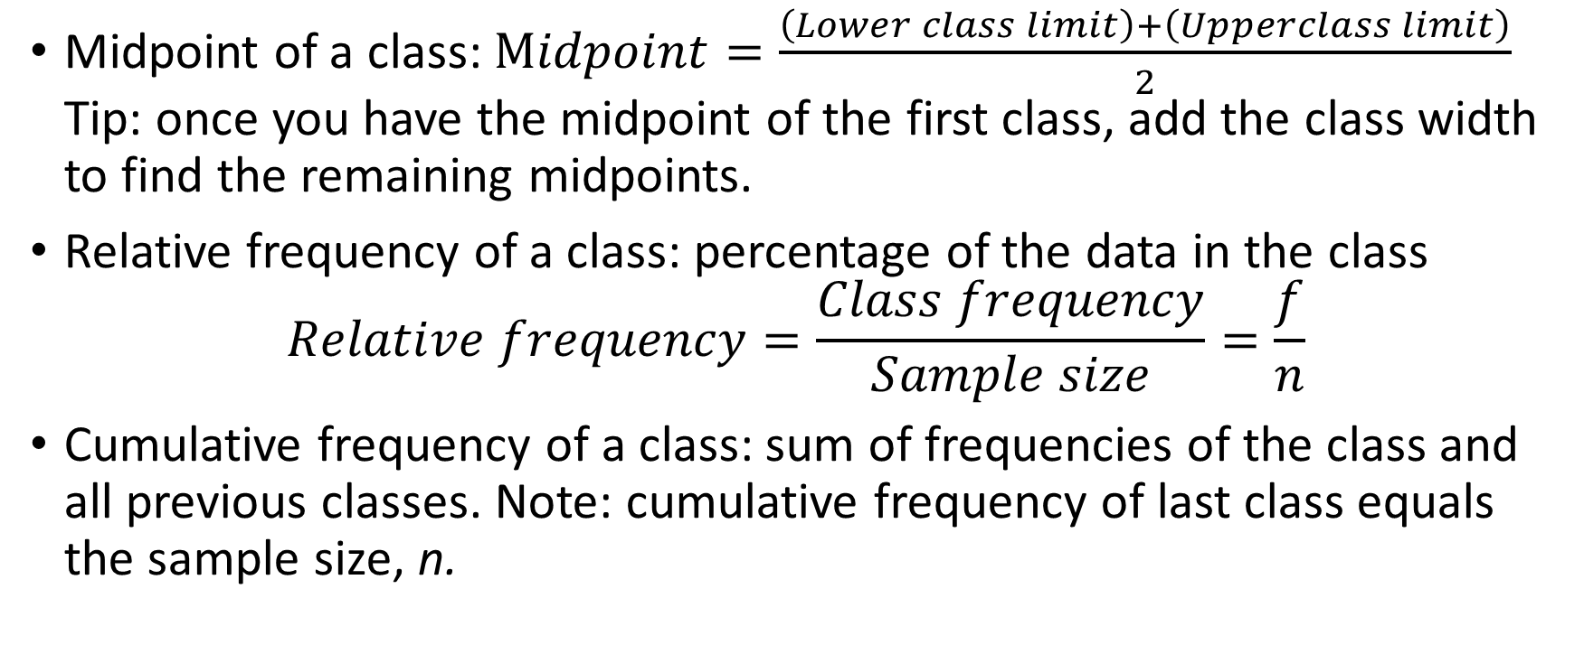
Additional Features of the Frequency Distribution
Midpoint of a class: $Midpoint=\frac{\left(Lower class limit\right)+\left(Upperclass limit\right)}{2}$ Tip: once you have the midpoint of the first class, add the class width to find the remaining midpoints.
Relative frequency of a class: percentage of the data in the class $Relative frequency=\frac{Class frequency}{Sample size}=\frac{f}{n}$
Cumulative frequency of a class: sum of frequencies of the class and all previous classes. Note: cumulative frequency of last class equals the sample size, n.

Slide 8
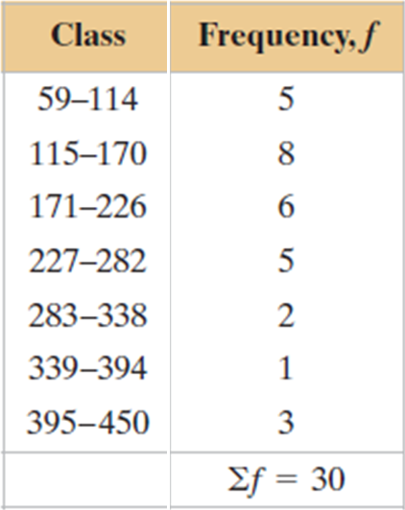
Example: Finding Midpoints, Relative Frequencies, and Cumulative Frequencies
Using the frequency distribution from example 1 (shown to the left), find the midpoint, relative frequency, and cumulative frequency of each class. Identify any patterns.
I did the first, you do the rest.

Slide 9
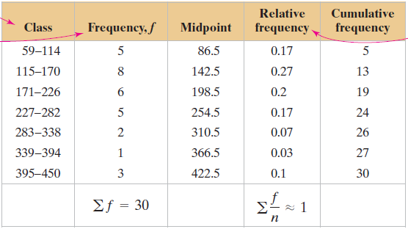
Example: Finding Midpoints, Relative Frequencies, and Cumulative Frequencies cont.

Slide 10
A Living Histogram
In pairs, help each other measure the span of your hands.
Record your personal hand size somewhere in the notes, then write it on the board. Remember your hand size.
Once the whole class has done this, create a frequency distribution with 5 classes.
Now that we have a frequency distribution each person will stand in the class that they fit in. Each class will have a line starting at the front of the class.
You have just created a living histogram.

Slide 11
Frequency Histogram
Frequency Histogram: graph that represents the frequency distribution. Note that often the frequency part is dropped.
Properties of a Histogram:
The horizontal scale is quantitative and measures data values
The vertical scale measures the frequencies of the classes.
Consecutive bars must touch (if there is an entry in the class)
Class Boundaries: Numbers that separate the classes without forming gaps. If you have integers, subtract .5 from the Lower Class Limit and add .5 to the Upper Class Limit

Slide 12
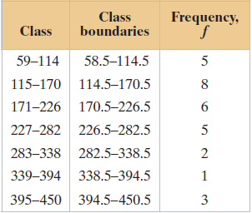
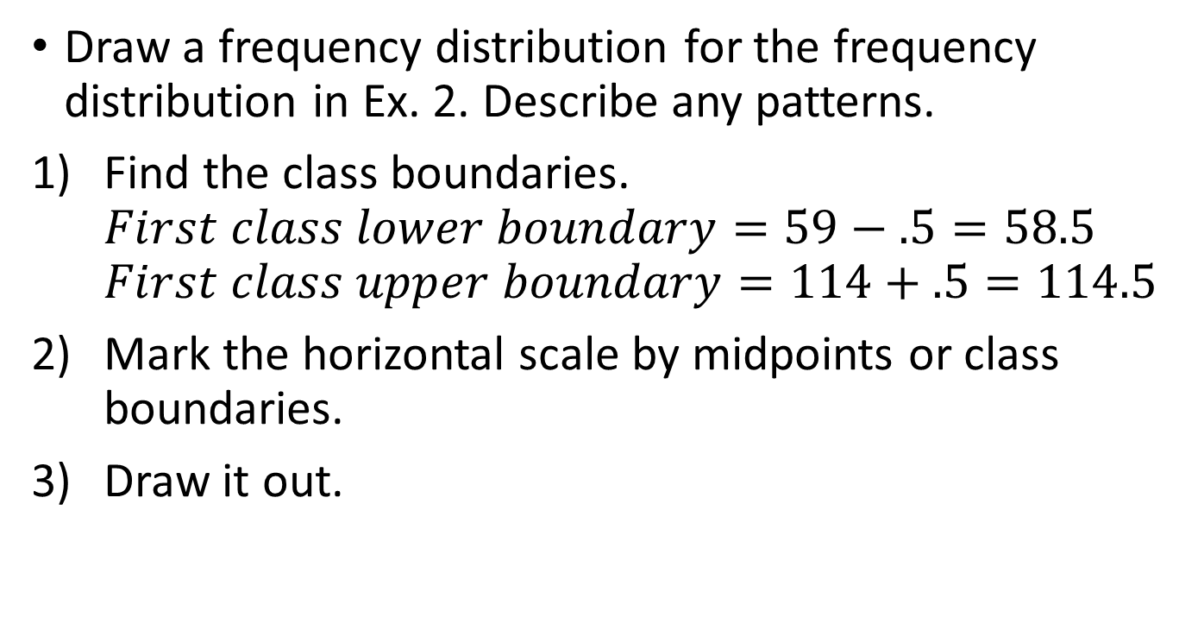
Constructing a Frequency Histogram
Draw a frequency distribution for the frequency distribution in Ex. 2. Describe any patterns.
Find the class boundaries. $First class lower boundary=59−.5=58.5$ $First class upper boundary=114+.5=114.5$
Mark the horizontal scale by midpoints or class boundaries.
Draw it out.

Slide 13
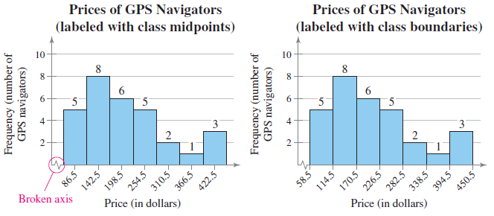
Constructing a Frequency Histogram cont.

Slide 14
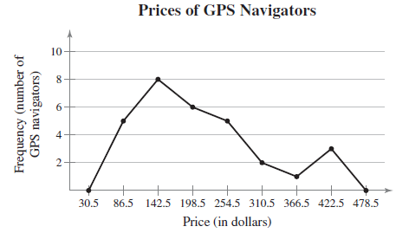
Frequency Polygon
Frequency polygon: a line graph drawn by using the midpoints of the histogram.
The frequency polygon below is from the histograms we just looked at. (you don’t have to draw the frequency polygon)

Slide 15
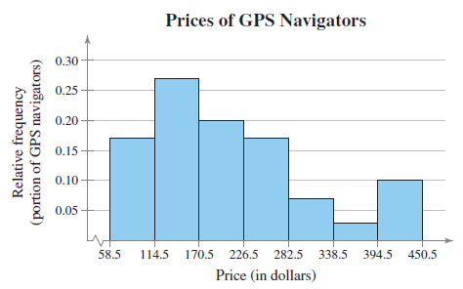
Relative Frequency Histogram
Relative Frequency Histogram: same shape and horizontal scale as a histogram with the vertical scale measure the relative frequencies, not simply the frequencies. In other words, the vertical scale is the percentages.
Below is a relative frequency histogram from the earlier examples.

Slide 16
Cumulative Frequency Graph
Cumulative Frequency Graph (Ogive, pronounce oh jive): line graph that displays the cumulative frequency of each class at its upper class boundary.
Horizontal axis has the upper boundary marks.
Vertical axis has the cumulative frequencies.
Steps:
Find the cumulative frequencies for each class.
Identify the scales.
Graph a point at each upper boundary.
Play connect the dots.

Slide 17
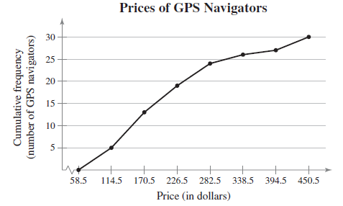
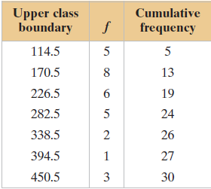
Constructing an Ogive
Below is the data that we found back in the second example. We will use this to create the ogive.

Slide 18
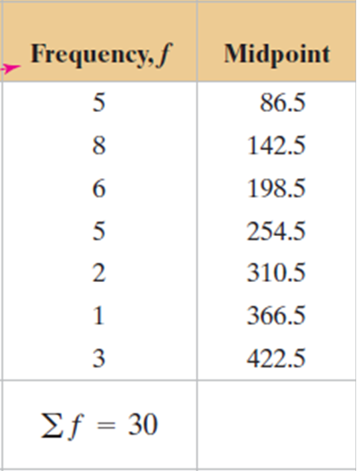
Using Technology
We can use calculators to do a lot of the work for us.
On your calculator, go to STAT.
In L1 enter the midpoints L2 enter the frequencies.
Now hit 2nd STATPLOT
Turn on Plot 1
Highlight the histogram option
Xlist: L1
Freq: L2
Hit ZOOM, 9
WINDOW then Xscl: 56
GRAPH

Slide 19
Using Technology Option 2
Go to L1 and enter all the data into one column.
Hit 2nd STAT PLOT
Turn on Plot 1
Highlight the histogram option
Xlist: L1
Freq: 1
Hit ZOOM, 9

Slide 20
Practice Problems
Pg. 47 #1 – 6, 11 – 17 odd, 21, 22, 29
On number 29, create a histogram using the calculators. Do not do what the book tells you to do.

