Slide 1
2.2 More Graphs and Displays
Bellwork (on a separate piece of paper to hand in):
Below is a data sample taken from an ATM over the course of a month. Each entry is the total amount of money taken out for the day (in 100s of dollars). A) Create a frequency distribution with relative frequency. B) If you put $9000 in the ATM each day, what percent of days in a month should you expect to run out of cash?
Hint: Use 60 – 69, 70 – 79, 80 – 89, 90 – 99, and 100 – 109 as your classes

Slide 2
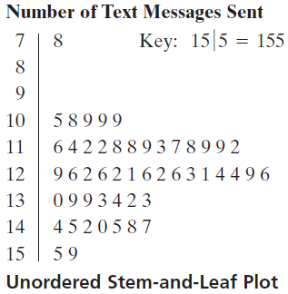
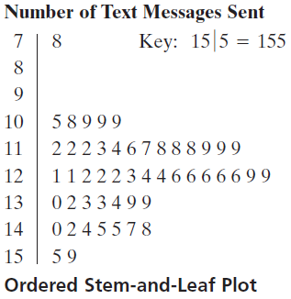
Constructing a Stem-and-Leaf Plot
The following are the numbers of text messages sent last week by the second floor of a college dormitory. Display the data in a stem-and-leaf plot. What can you conclude?

Slide 3
Constructing a Stem-and-Leaf Plot cont.
Here are the daily total withdrawals at an ATM (in 100s of dollars) for 30 days. Display the data in a stem-and-leaf display. How much money should be in the ATM during normal day?

Slide 4
Constructing a dot plot
Use a dot plot to organize the text messaging data given in Example 1. What can you conclude from the graph?

Slide 5
Constructing a dot plot cont.
Use a dot plot to organize the text messaging data given from the ATM example. What can you conclude from the graph?

Slide 6
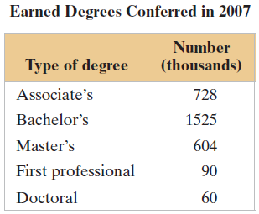
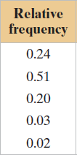
Constructing a Pie Chart
The members of earned degrees conferred (in thousands) in 2007 are shown in the table. Use a pie chart to organize the data. What can you conclude?
Start by finding the relative frequency, or percent.
Now use the formula: Central Angle = $360°∙relative frequency$

Slide 7
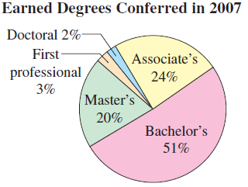
Constructing a Pie Chart cont.
Finally, construct the Pie Chart (this would be done with technology).
You need to have an approximation of the angles to be sure it is done correctly.

Slide 8
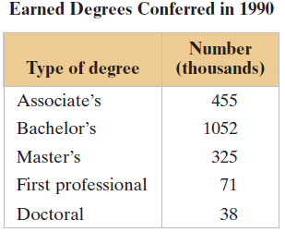
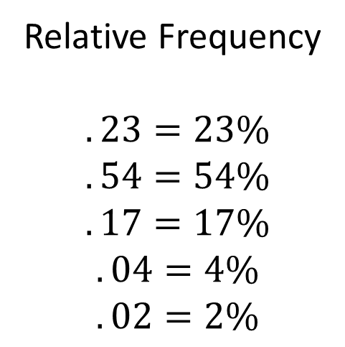
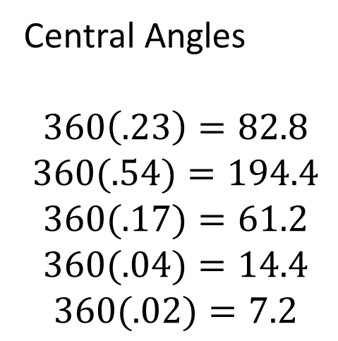
Constructing a Pie Chart cont.
The members of earned degrees conferred (in thousands) in 1990 are shown in the table. Use a pie chart to organize the data. Compare the 1990 pie chart to the 2007.
Relative frequencies
Central Angles
Relative Frequency
$$.23=23\%$$
$$.54=54\%$$
$$.17=17\%$$
$$.04=4\%$$
$$.02=2\%$$
Central Angles
$$360\left(.23\right)=82.8$$
$$360(.54)=194.4$$
$$360(.17)=61.2$$
$$360(.04)=14.4$$
$$360(.02)=7.2$$

Slide 9
Constructing a Pie Chart cont.

Slide 10
Constructing a Pareto Chart (Decreasing Bar Chart)
Note: Make sure the bars go in decreasing height.
Use the frequencies (in this case dollars) for the vertical axis and categories on the horizontal axis.

Slide 11
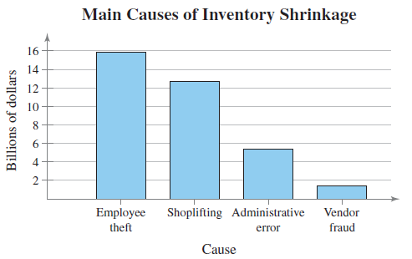
Constructing a Pareto Chart (Bar Chart)
Notice the scale. It does not make sense to do by single dollars, the graph would be hard to create and hard to compare.
Where would your focus be in loss prevention?

Slide 12
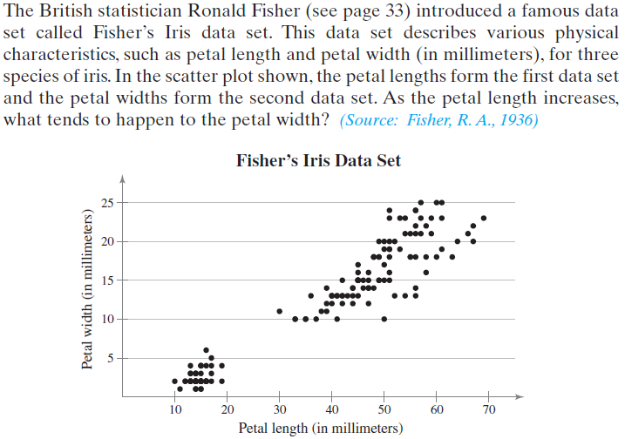
Interpreting a Scatter Plot

Slide 13
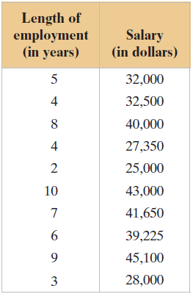
Interpreting a Scatter Plot
Treat the data values as ordered pairs (x, y).
Graph them on a grid.

Slide 14
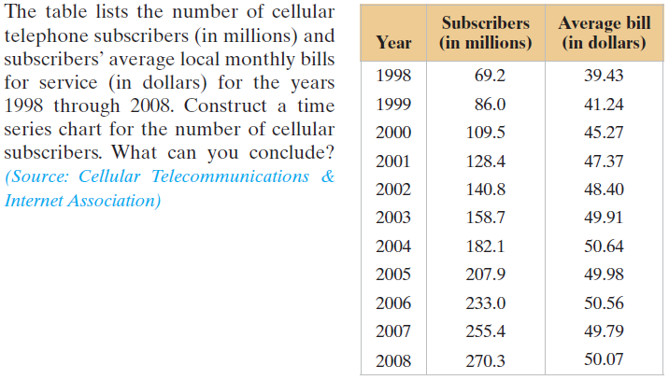
Constructing a Time Series Chart
Let the horizontal axis represent the years and let the vertical axis represent the number of subscribers in millions.

Slide 15
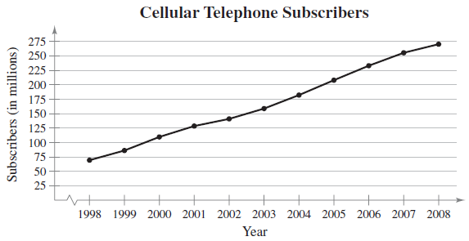
Constructing a Time Series Chart

Slide 16
Constructing a Time Series Chart
Construct a time series chart for subscribers’ average local monthly cellular telephone bills for the years 1998 through 2008. What can you conclude?
Year | Average Bill (in dollars)
1998 | 39.43
1999 | 41.24
2000 | 45.27
2001 | 47.37
2002 | 48.40
2003 | 49.91
2004 | 50.64
2005 | 49.98
2006 | 50.56
2007 | 49.79
2008 | 50.07

Slide 17
Practice Problems
Pg. 60 #1, 2, 9, 10, 13, 16 – 19, 22, 25, 35 – 38

