Slide 1
2.3 Measures of Central Tendency (mean, median, mode)

Slide 2
Mean (finding the average)
Make sure you have these equations written down.
$μ=$ mu and represents population mean
$\overline{x}=$ sample mean
$N=$ population entries
$n=$ sample entries

Slide 3
Finding a Sample Mean
The prices (in dollars) for a sample of round-trip flights from Chicago, Illinois to Cancun, Mexico are listed. What is the mean price of the flights?

Slide 4
Finding Median of an odd sample size (middle entry)
Find the median of the flight prices (from example 1) below.
When finding the median, ALWAYS order the numbers.
Median is 427.

Slide 5
Finding the Median of an even sample
Find the median of the flight prices listed below.
Notice they are already organized.
Since it is even, find the midpoint of the two middle prices: 397 and 427, which is 412.
So the median is 412.

Slide 6
Finding the Mode (most frequent)
Find the mode of the flight prices from example 1
Organizing the data is not required, but does make it easier.
The number that occurs the most frequently is 397.
Note: A stem-and-leaf plot would also be helpful when dealing with a large number of entries.

Slide 7
Finding the Mode
In a survey, 1000 U.S. adults were asked if they thought public cellular phone conversations were rude. Of those surveyed, 510 responded “Yes,” 370 responded “No,” and 120 responded “Not sure.” What is the mode of the responses?

Slide 8
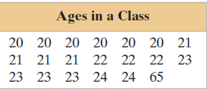
Comparing the Mean, Median, and Mode
On your own: Find the mean, median and mode of the sample ages of students in a class shown in the table. Which measure of central tendency best describes a typical entry of this data set? Are there any outliers?
Start by finding $n$
Mean: $\overline{x}=\frac{Σx}{n}=\frac{475}{20}=23.8$ years
Median: $\frac{21+22}{2}=21.5$ years
Mode: 20
Note: the mean is more affected by outliers than the median.

Slide 9
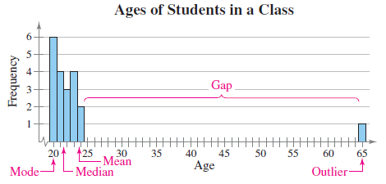
Seeing outliers on a histogram
Looking at a histogram for the ages in our sample class, we can see a large gap. In this case, the median would be the best measure of central tendency.

Slide 10
Finding a weighted mean ($\overline{x}=\frac{Σx∙w}{Σw}$, $w=$ weight)
It will help to organize the data into a table of some sort.

Slide 11
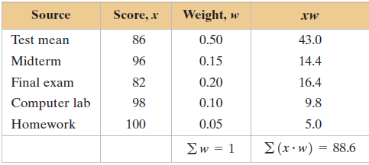
Finding a weighted mean cont.
Plugging it into the formula: $\overline{x}=\frac{Σx∙w}{Σw}=\frac{88.6}{1}=88.6$

Slide 12
Finding a weighted mean cont.
For the month of May, a checking account has a balance of $523 for 15 days, $1985 for 5 days, $1410 for 5 days, and $348 for 6 days. What is the account’s mean daily balance for May?

Slide 13
Mean of a Frequency Distribution
Make sure the equation is written in your notes, be careful it is an approximation.
$x=$the midpoint of a class
$f=$ the frequency of the corresponding class
$n=$ the total number of frequencies

Slide 14
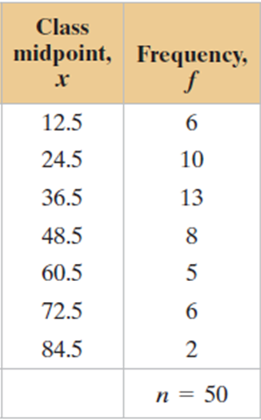
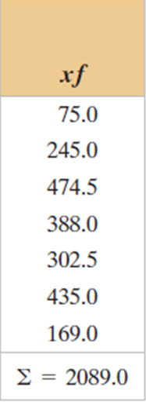
Finding the Mean of a Frequency Distribution
Use the frequency distribution at the left to approximate the mean number of minutes that a sample of Internet subscribers spent online during their most recent session.
Once again, plugging the information into the formula would be $\frac{2089.0}{50}≈41.8$ minutes

Slide 15
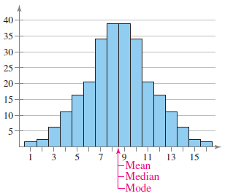
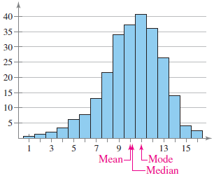
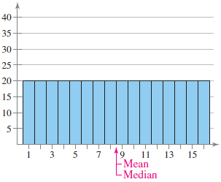
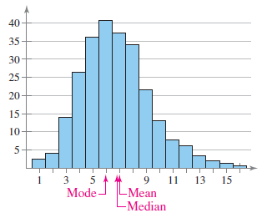
Shapes of distributions
Symmetric
Skewed Left
Uniform
Skewed Right

Slide 16
Practice Problems
Pg. 72 #1 – 4, 9 – 18, 38, 40 – 43

