Slide 1
2.4 Measures of Variance Part 1
Review:
Find the mean, median, and mode of the data set below.
Mean = 7.1, Median = 6, and Mode = 6

Slide 2
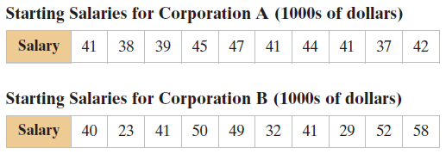
Review: Finding Range
Two corporations each hired ten graduates. The starting salaries for each graduate are shown below. Find the range of both sets of data below.

Slide 3
Finding Deviation
Find the deviation of Corporation A.
Find the mean of the data
41.5
Find the deviation by subtracting the mean from each value.
Notice what the sum of the deviations ends up being.
In Stats, we want to find out how spread out the data is. If the sum is zero, there is no way to measure the spread.

Slide 4
Finding the Population Standard Deviation
Find the population standard deviation of the starting salaries for Corporation A from example 1.
Square the deviations and add them together (sum of squares, $SS_{x}$)
Divide by $N=10$
$\frac{88.5}{10}=8.85$, which gives you variance, $σ^{2}$.
Square root the variance to get the standard deviation, $\sqrt{8.85}=2.975$

Slide 5
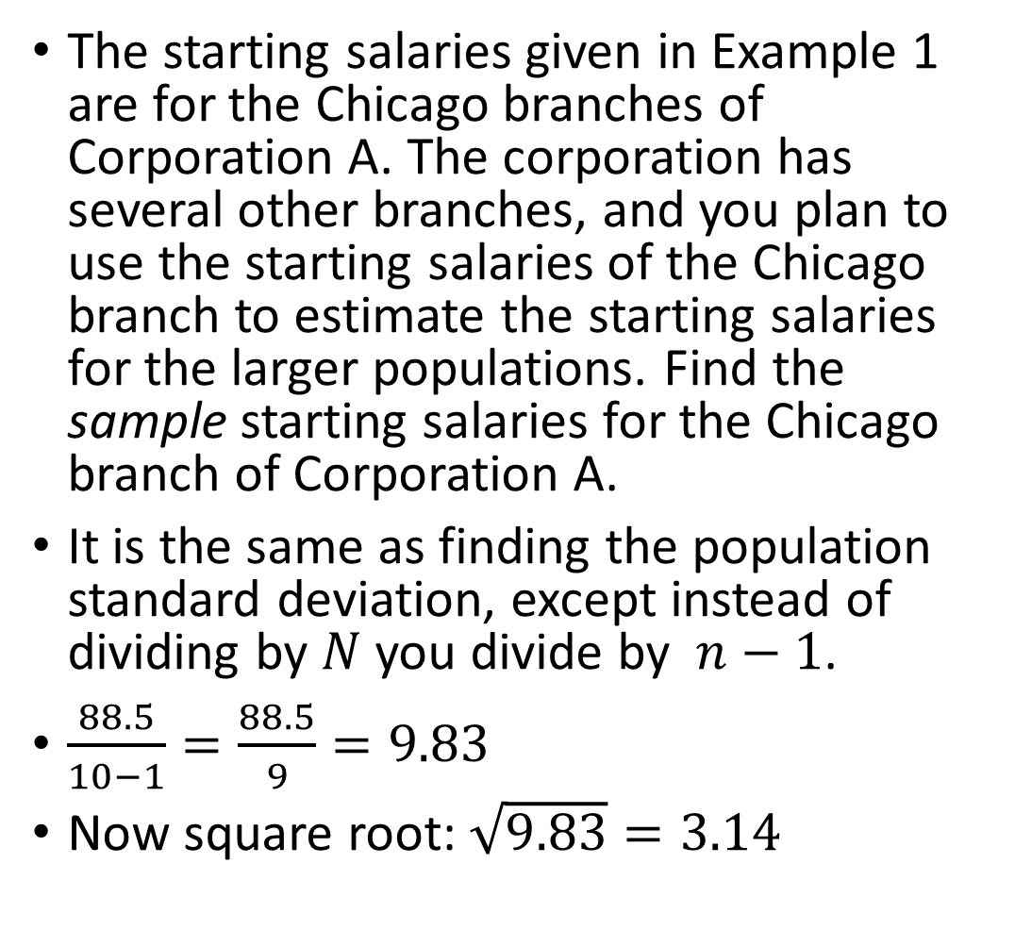
Finding Sample Standard Deviation
The starting salaries given in Example 1 are for the Chicago branches of Corporation A. The corporation has several other branches, and you plan to use the starting salaries of the Chicago branch to estimate the starting salaries for the larger populations. Find the sample starting salaries for the Chicago branch of Corporation A.
It is the same as finding the population standard deviation, except instead of dividing by $N$ you divide by $n−1$.
$\frac{88.5}{10−1}=\frac{88.5}{9}=9.83$
Now square root: $\sqrt{9.83}=3.14$

Slide 6
On your own
Corporation B has requested that you find the population standard deviation and the sample standard deviation for their 10 graduates.
Answer: Population Standard Deviation: 10.5 Sample Standard Deviation: 11.07

Slide 7
Practice Problems
Pg. 90 #4, 7, 11 – 14, 21

