Slide 1
4.1 Probability Distributions

Slide 2
Vocab Refresher
Random Variable x represents a numerical value associated with each outcome of a probability experiment
Discrete Random Variable has a finite or countable number of possible outcomes that can be listed (key: counting)
Continuous Random Variable has an uncountable number of possible outcomes, represented by an interval on the number line (key: measuring)

Slide 3
Discrete or Continuous?
Number of students present
Answer: Discrete
Drive time to get to school
Answer: Continuous
Student Grade Levels
Answer: Discrete (freshman, sophomore …)
Number of red M&M’s in a bag
Answer: Discrete
Heights of students in class
Answer: Continuous
Fortune 500 companies that lost money last year
Answer: Discrete
Volume of gasoline in a 21-gallon tank
Answer: Continuous

Slide 4
Discrete Probability Distributions
Lists all the possible values that a discrete random variable can take.
Each value has a probability that goes along with it.
The same rules of probability apply here:
$0≤P(x)≤1$
$ΣP\left(x\right)=1$
Creating a Discrete Probability Distribution
List the values or scores with their frequencies
Add up all the total number of frequencies
Find the probability of each value
Check that the probabilities add up to 1

Slide 5
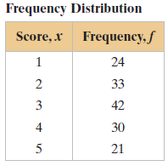
Constructing and Graphing Discrete Probability Distributions
An industrial psychologist administered a personality inventory test for passive-aggressive traits to 150 employees. Each individual was given a score from 1 to 5, where 1 was extremely passive and 5 extremely aggressive. A score of 3 indicated neither trait. The results are shown below. Construct a probability distribution for the random variable x. Then graph the distribution using a histogram.
Start by finding the probability, then graph it.
What is the total number of frequencies?

Slide 6
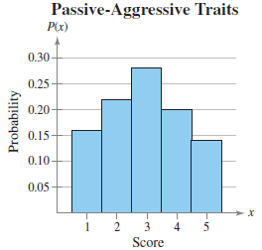
Constructing and Graphing Discrete Probability Distributions
From the probabilities you can graph it by hand or by using a calculator. (if you do not remember, you may want to get a refresher on how to do that)
The graph will look like this:

Slide 7
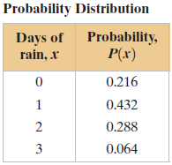
Verifying Probability Distributions
Verify that the distribution below is a probability distribution.
What are the two restrictions?
Answer:
$0≤P(x)≤1$
$ΣP\left(x\right)=1$
Does it work?
Answer: Yes

Slide 8
Mean, Variance, and Standard Deviation
Mean of a discrete random variable: $μ=Σx∙P(x)$
Variance of a discrete random variable: $σ^{2}=\sum{{\left(x−μ\right)}^{2}P(x)}$
Standard deviation of a discrete random variable:
$$σ=\sqrt{σ^{2}}=\sqrt{\sum{{\left(x−μ\right)}^{2}P(x)}}$$

Slide 9
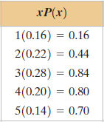
Finding the mean of a probability distribution
The probability distribution for the personality inventory test for passive aggressive traits discussed in Example 2 is given below. Find the mean score. What can you conclude?
Simply multiply each value by its probability, then add them all together.

Slide 10
Finding the variance and standard deviation of a probability distribution
The probability distribution for the personality inventory test for passive aggressive traits discussed in Example 2 is given to the left. Find the variance and standard deviation of the probability distribution. Remember $μ=2.94$
This is similar to finding the variance and standard deviation as we did earlier this year except after square the difference between the value and the mean, we multiply by the probability.

Slide 11
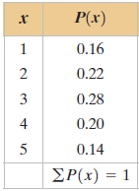
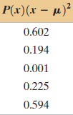
Finding the variance and standard deviation of a probability distribution
Start by subtracting the mean from each value
Then square each result
Multiply the squared numbers by the probability
Add them together to find the variance
Finally, square root the variance to find the standard deviation

Slide 12
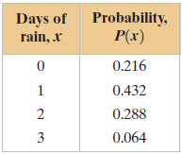
Try it on your own
Find the mean, variance, and standard deviation of the table shown below.
Mean: 1.2
Variance: .72
Standard Deviation: .848528

Slide 13
Expected Value
Expected value of a discrete random variable is equal to the mean of the random variable.
Expected Value$=E\left(x\right)=μ=\sum{x∙P(x)}$

Slide 14
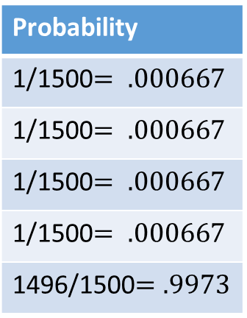
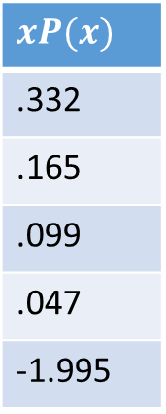
Expected value of a game
At a raffle, 1500 tickets are sold at $2 each for four prizes of $500, $250, $150, and $75. You buy one ticket. What is the expected value of your gain?
What are your values for the table?
Answer: $500−2=498, 250−2=248, 150−2=148, 75−2=73$, or you could simply win nothing which puts your gain at $−2$.
What is the probability of each gain?
Find the expected value.
$\sum{xP\left(x\right)=−1.352}$
On average, you can expect to loose $1.35.
Is this game fair?
What would the expected value of a completely fair game be?
Gain
498
248
148
73
-2
Probability
1/1500$= .000667$
1/1500$= .000667$
1/1500$= .000667$
1/1500$= .000667$
1496/1500$=.9973$
$$xP(x)$$
.332
.165
.099
.047
-1.995

Slide 15
Practice Problems
Pg. 197 #2, 5 – 10, 13 – 23 odd, 28, 30, 32, 36, 42

