Slide 1
5.4 Sampling Distributions and the Central Limit Theorem

Slide 2
Definitions
Sampling Distribution: probability distribution of a sample statistic (usually the mean) that is formed when samples with size $n$ are repeatedly taken from the population.
Sampling Distribution of Sample Means: when the sampling distribution is looking at the samples means.
A sampling distribution could be made for any of the sample statistics (standard deviation or variance for example)

Slide 3
Properties of Sampling Distributions of Sample Means
The mean of the sample means (taking the average of all the samples’ means) is the same as the population mean $μ_{\overline{x}}=μ$
The standard deviation of the sample means ($σ_{\overline{x}}$) is equal to the population standard deviation ($σ$) divided the square root of the sample size $n$. This is called the standard error of the mean. $σ_{\overline{x}}=\frac{σ}{\sqrt{n}}$

Slide 4
Example
You write the population values $\left\{1, 3, 5, 7\right\}$ on slips of paper and put them in a box. Then you randomly choose two slips of paper, with replacement. A) List all possible samples of size $n=2$ and calculate the mean of each. These means form the sampling distribution of the sample means. B) Find the mean, variance, and standard deviation of the sample means. C) Compare your results with the mean $μ=4$, variance $σ^{2}=5$, and standard deviation $σ=\sqrt{5}≈2.236$of the population.

Slide 5
The Central Limit Theorem
Allows us to create models to estimate the population parameters from sample statistics.
If samples of size $n$, where $n≥30$, are created from a population (with a mean and standard deviation), then the sampling distribution of sample means approximates a normal distribution. Bigger samples means more accurate estimates.
If the population is normally distributed, then the sampling distribution of sample means is normally distributed for any sample size.
No matter what: $μ_{\overline{x}}=μ$
$$σ_{\overline{x}}=\frac{σ}{\sqrt{n}}$$

Slide 6
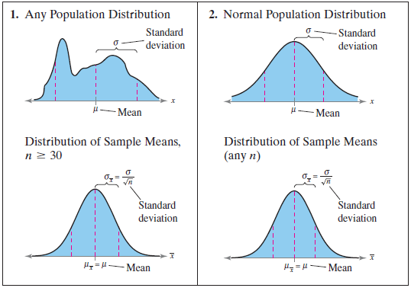
The Central Limit Theorem

Slide 7
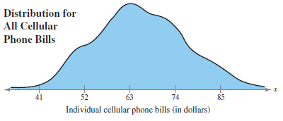
Cellular phone bills for residents of a city have a mean of $63 and a standard deviation of $11, as shown in the following graph. Random samples of 100 cellular phone bills are drawn from this population and the mean of each sample is determined. Find the mean and standard error of the mean of the sampling distribution. Then sketch a graph of the sampling distribution of sample means.

Slide 8
Suppose the training heart rates of all 20-year-old athletes are normally distributed, with a mean of 135 beats per minute and standard deviation of 18 beats per minute, as shown in the following graph. Random samples of size 4 are drawn from this population, and the mean of each sample is determined. Find the mean and standard error of the mean of the sampling distribution. Then sketch a graph of the sampling distribution of sample means.

Slide 9
Probability and Central Limit Theorem
$z=\frac{value−mean}{standard deviation}=\frac{\overline{x}−μ_{\overline{x}}}{σ_{\overline{x}}}$
You randomly select 50 drivers ages 15 to 19. If the average time a driver between the ages of 15 and 19 spends in their car is 25 minutes with a standard deviation of 1.5 minutes, what is the probability that the mean time the 50 drivers selected spend driving each day is between 24.7 and 25.5 minutes?

Slide 10
Try This
You randomly select 100 drivers ages 15 to 19 from the previous example. What is the probability that the mean time they spend driving each day is between 24.7 and 25.5 minutes. Use µ = 25 and σ = 1.5

Slide 11
The mean room and board expense per year at four-year colleges is $7540. You randomly select 9 four-year colleges. What is the probability that the mean room and board is less than $7800? Assume that the room and board expenses are normally distributed with a standard deviation of $1245.

Slide 12
An education finance corporation claims that the average credit card debts carried by undergraduates are normally distributed, with a mean of $3173 and a standard deviation of $1120. (Adapted from Sallie Mae)
1. What is the probability that a randomly selected undergraduate, who is a credit card holder, has a credit card balance less than $2700?
2. You randomly select 25 undergraduates who are credit card holders. What is the probability that their mean credit card balance is less than $2700?
3. Compare the probabilities from (1) and (2) and interpret your answer in terms of the corporation’s claim.

Slide 13
Practice Problems
Pg. 274 # 1 – 22, 25- 30, 33-38

